Slide 1

Consulting on data analysis with EC SEQ BIOINFORMATICS

Slide 2
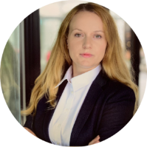
Consulting – Regulation & Clinical Trials
Advice & training
Support for clinical trials
Networking
Nicole Modler
Patient registry & biobank
Notes:
Speakers from Leipzig & Dresden
Scientists and Clinicians
Chemnitz also represented, not on the speaker level but in our Steering board (Governance)

Slide 3
Consulting – Regulation & Clinical Trials
Advice & training
General advice for clinical trials
Regulatory advice
Educational events
Working papers
Support for clinical trials
Support with sponsor choice
Support with trial protocols
Funding acquisition support
Support with PEI advices
Networking
Meetings for and with professionals
Meetings for and with patients
Nicole Modler
Patient registry & biobank
SHIMMER registry and biobank
Notes:
Speakers from Leipzig & Dresden
Scientists and Clinicians
Chemnitz also represented, not on the speaker level but in our Steering board (Governance)

