Slide 1

Consulting on data analysis with EC SEQ BIOINFORMATICS

Slide 2

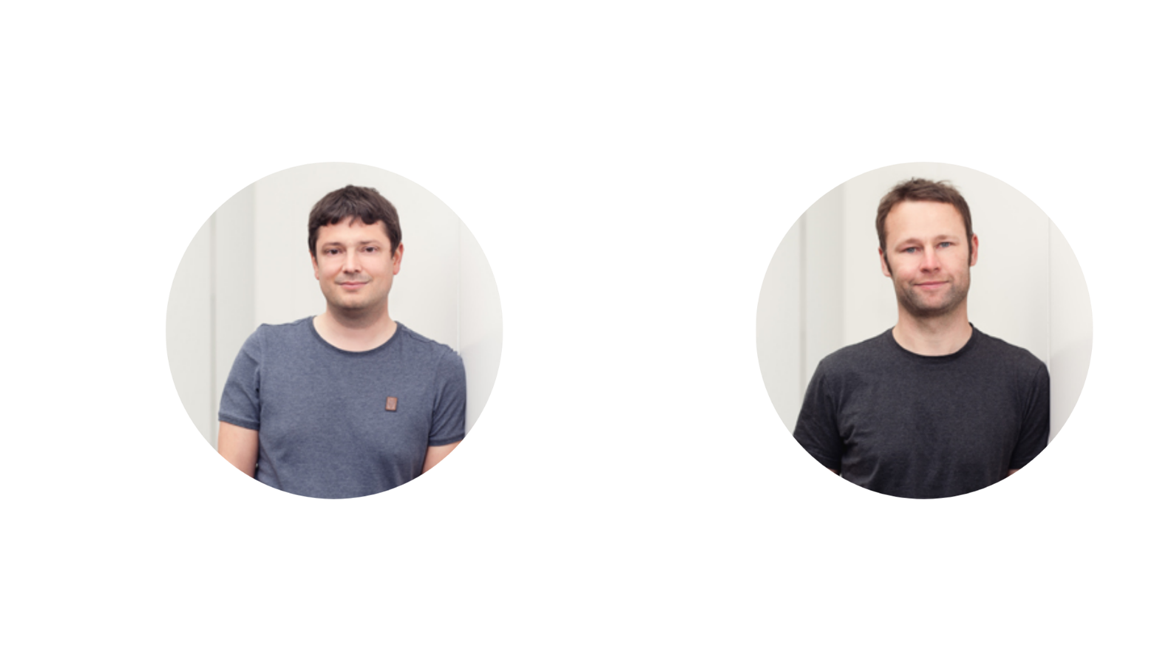

Consulting – Data Analysis by
David Langenberger
Mario Fasold
Notes:
Speakers from Leipzig & Dresden
Scientists and Clinicians
Chemnitz also represented, not on the speaker level but in our Steering board (Governance)

Slide 3
ecSeq Bioinformatics
Offerings for SaxoCell – Empowering Bioinformatics Excellence
Cluster-Internal Information Session
Best practices for project planning and bioinformatics workflows
Comparison: In-house vs. professional bioinformatics services
Tailored solutions for complex bioinformatics challenges
Tailored Training Courses
Galaxy Workshop
Custom Nextflow Workshop
Nanopore Sequencing Workshop (Under Consideration)
Advisory Services
One-on-One Consulting
Tailored support for specific research projects
Expertise in project design, data analysis, and interpretation

Slide 4


ecSeq Bioinformatics
Offerings for SaxoCell – Empowering Bioinformatics Excellence
Cluster-Internal Information Session on NGS
When? December 3, 2024
10am – 11am
Where? Online (Teams-Meeting)
Who? All interested SaxoCell researchers planning to work with NGS
Hosts:
Dr. Conny Blumert
Department of Diagnostics
Fraunhofer Institute for Cell Therapy and Immunology, IZI
Dr. David Langenberger
ecSeq Bioinformatics GmbH

