Slide 1
Consulting on NGS-technologies @Fraunhofer IZI

Slide 2
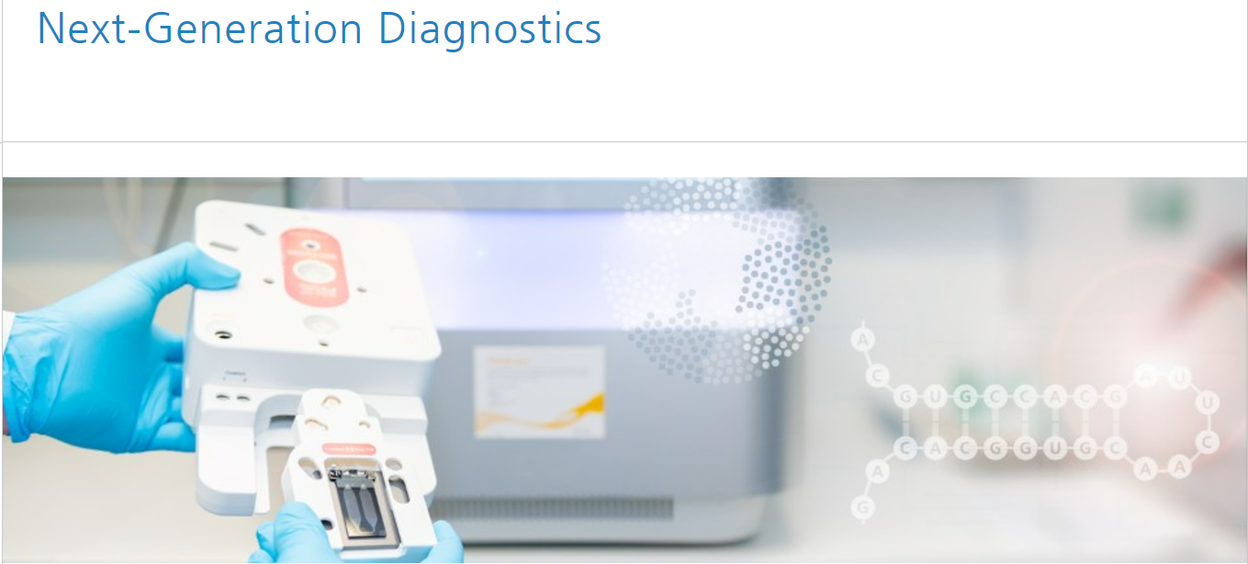
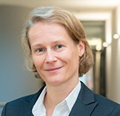
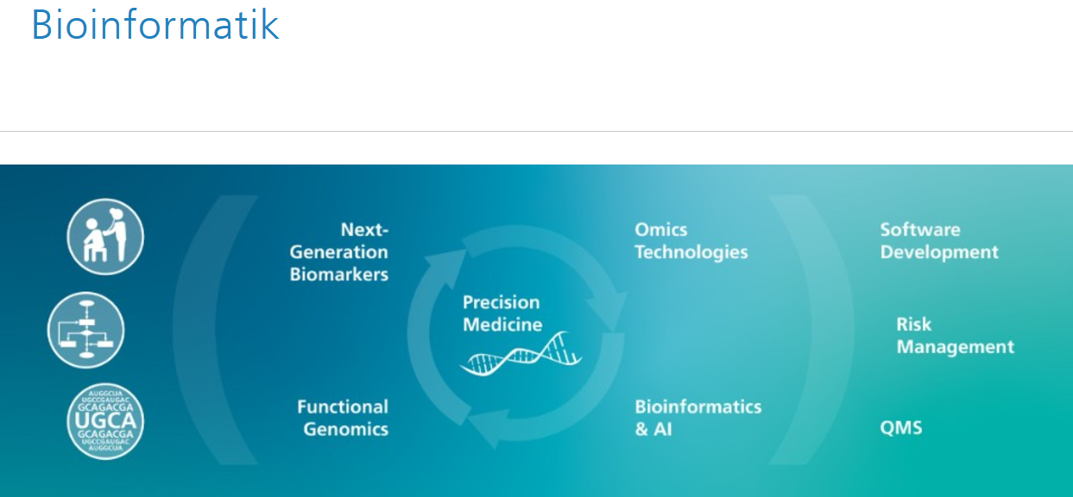
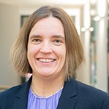
Consulting – Data Analysis by Fh IZI
Dr. Conny Blumert
Next-Generation Diagnostics Unit
conny.blumert@izi.fraunhofer.de
Conny Blumert
Dr. Kristin Reiche
Bioinformatics Unit
kristin.reiche@izi.fraunhofer.de
Kristin Reiche

Slide 3
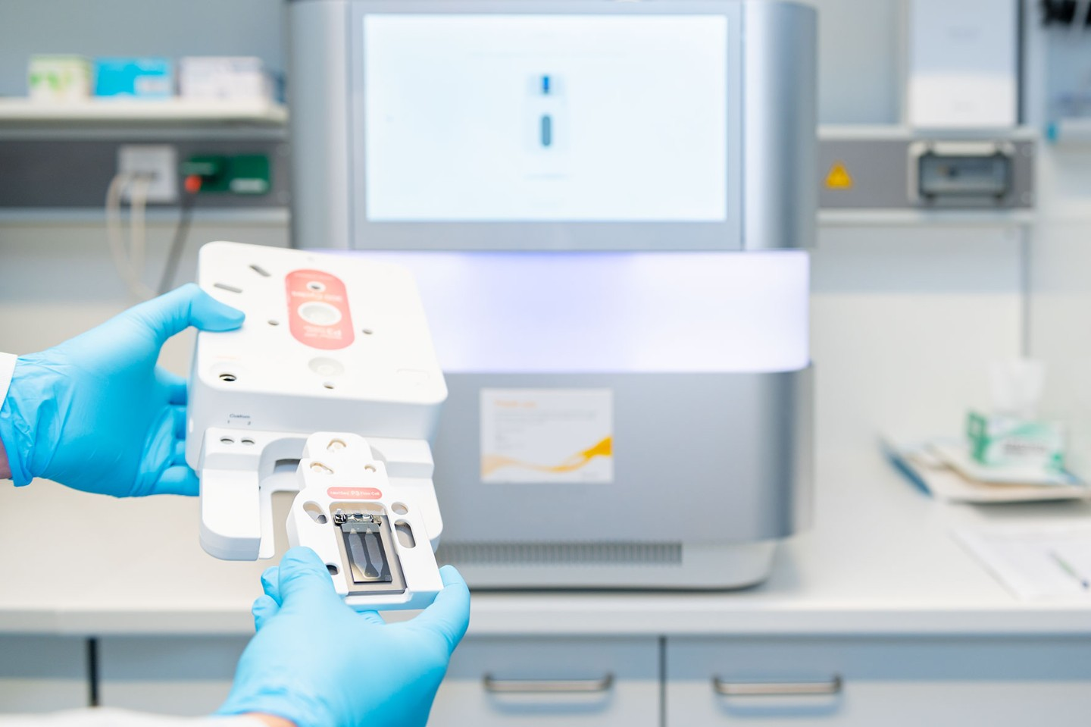
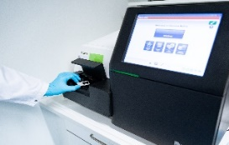
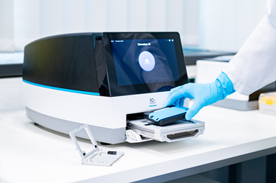
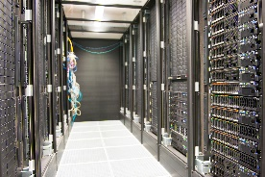
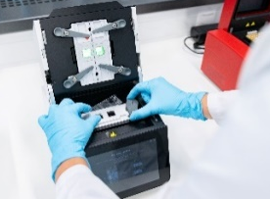
Biomarker Center at Fraunhofer IZI
Genomics & Transcriptomics
Methods
Technical equipment
Classical NGS methods
Next-Generation Sequencing (Short Read)
Whole transcriptome sequencing (mRNA and total RNA)
Whole genome and exome sequencing
small genome and 16S sequencing
NextSeq 2000 (Illumina) Application: sequencing of genomes, transcriptomes and single cells
MiSeq (Illumina) Application: sequencing of smaller genomes and amplicons
Advanced NGS methods
Single-cell multi-omics
Spatial transcriptomics
Single cell Sequencing
Chromium X (10x Genomics) Application: cell separation for single-cell sequencing
Bioinformatics
Data storage and computing
Spatial transcriptomics
High Performance Computing Cluster
CytAssist (10x Genomics) Application: tissue transfer to Visium slides

