Slide 1
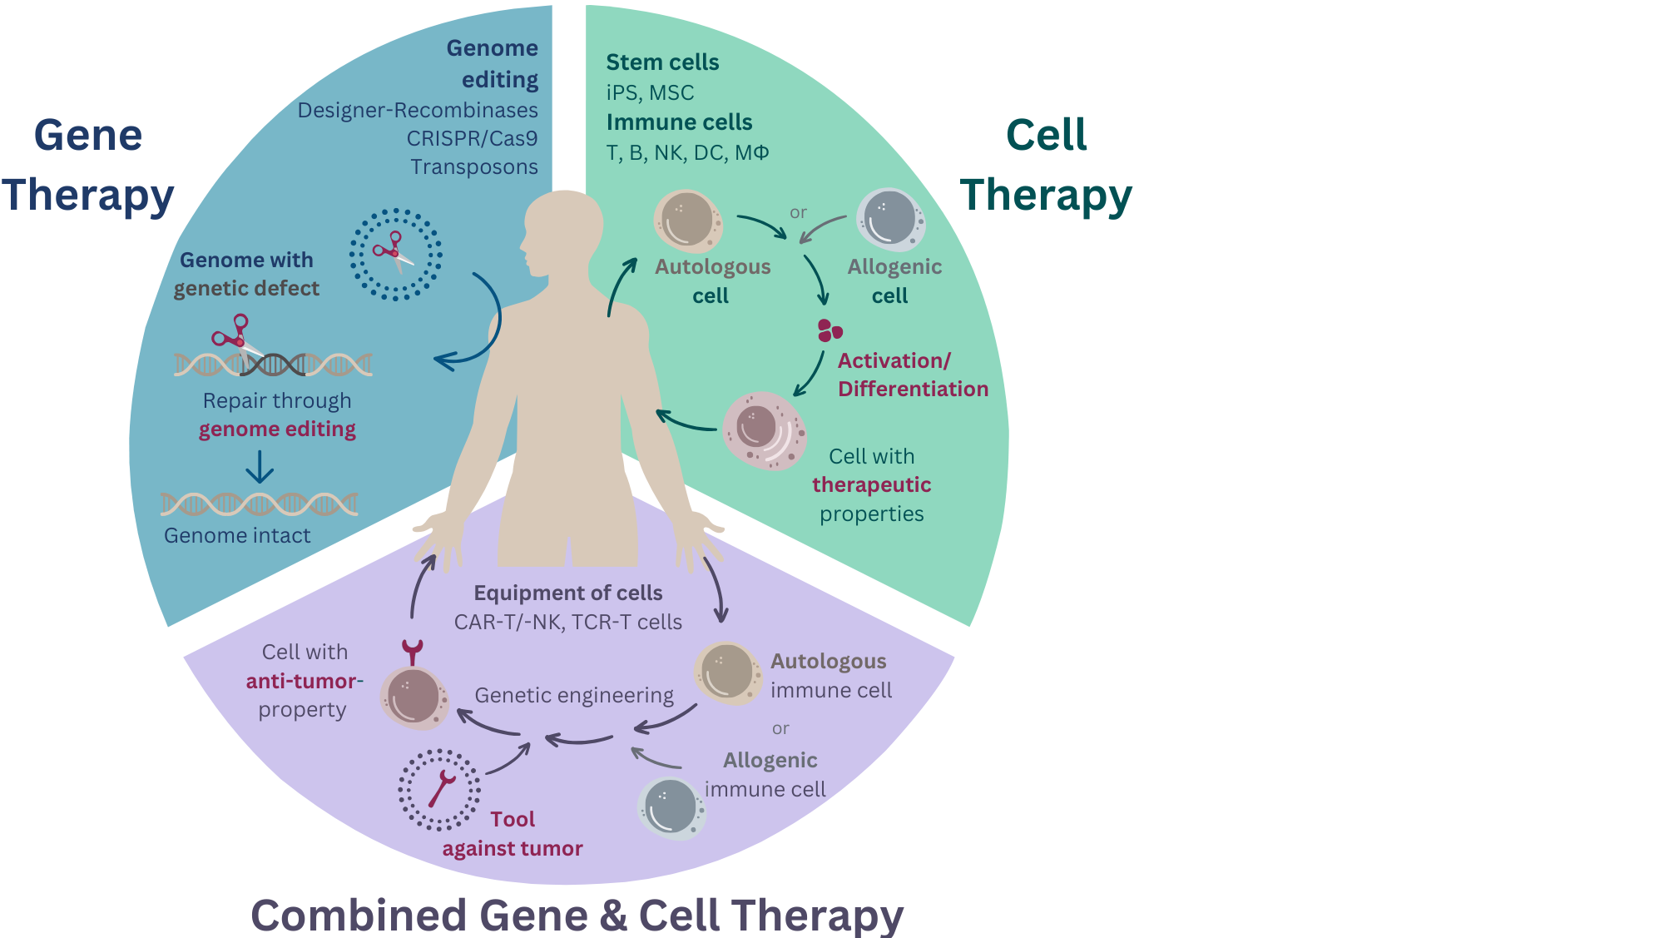

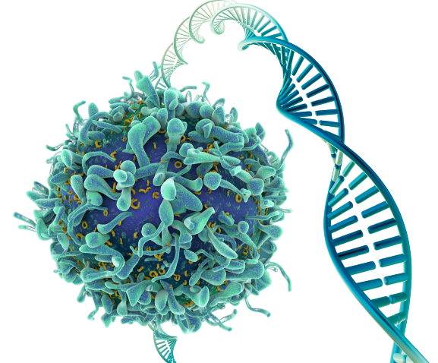
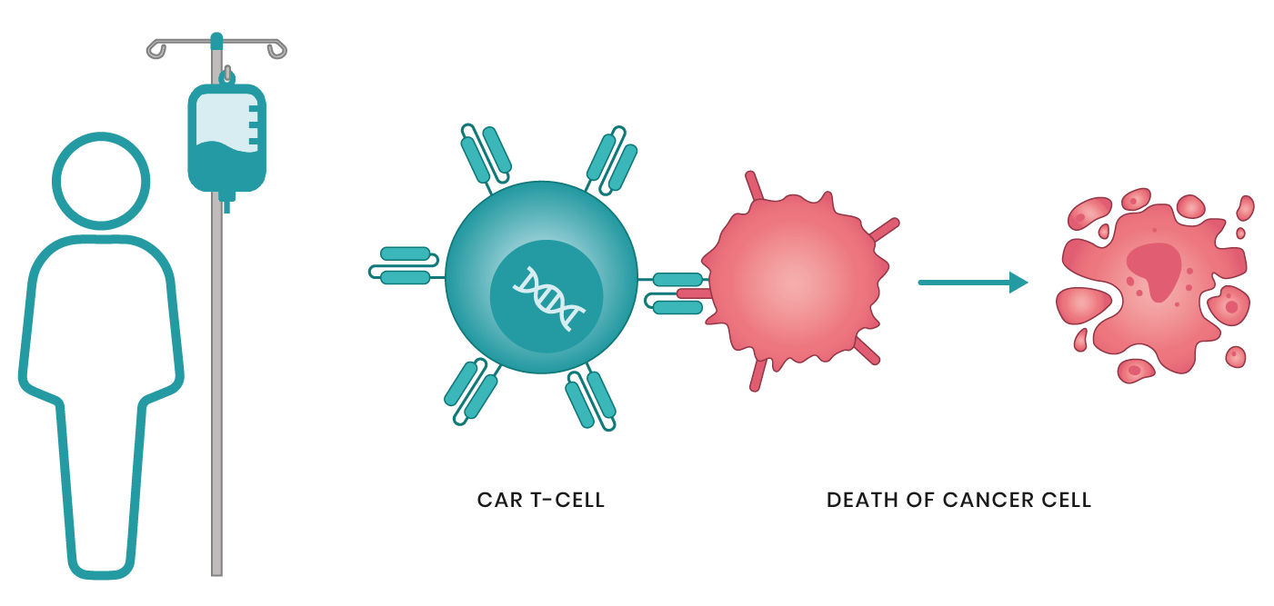
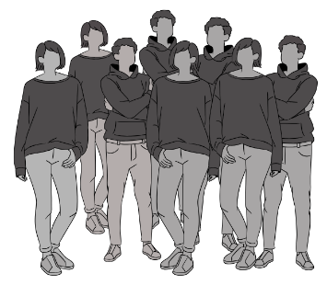

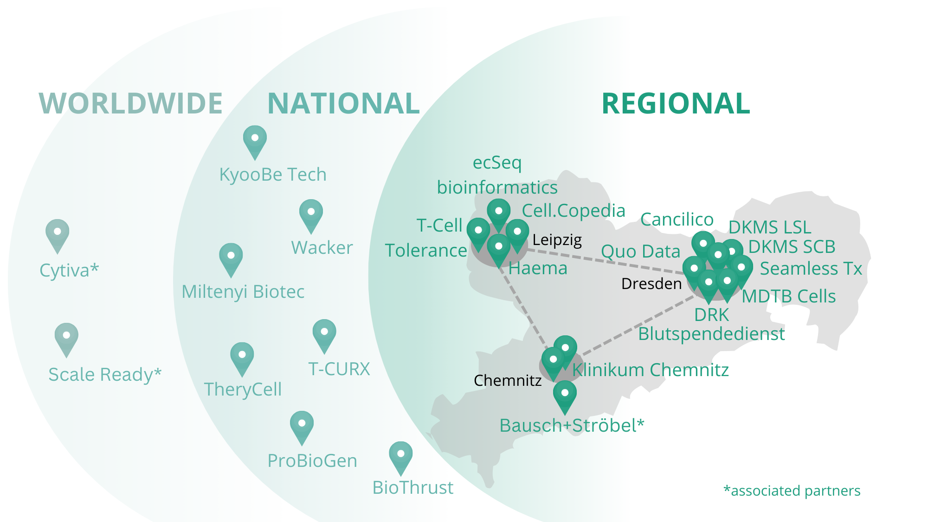

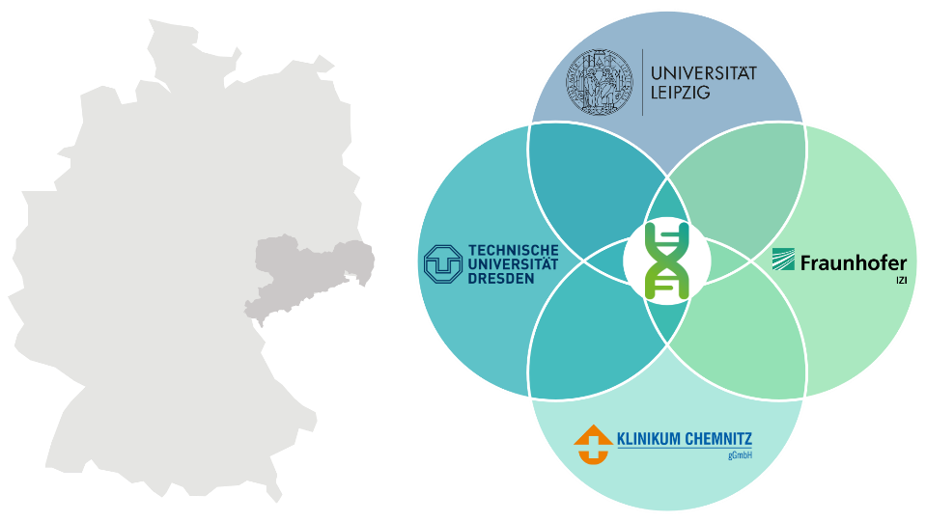
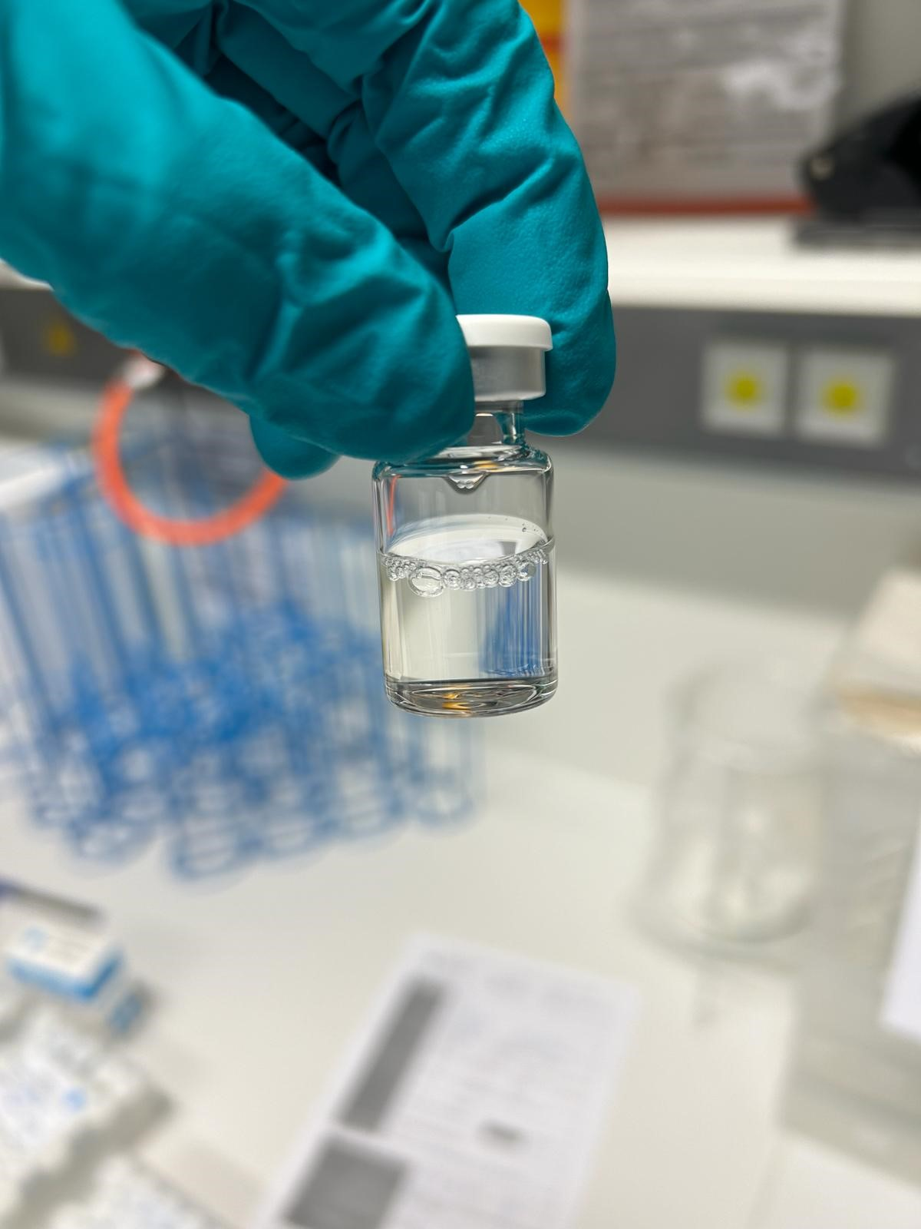
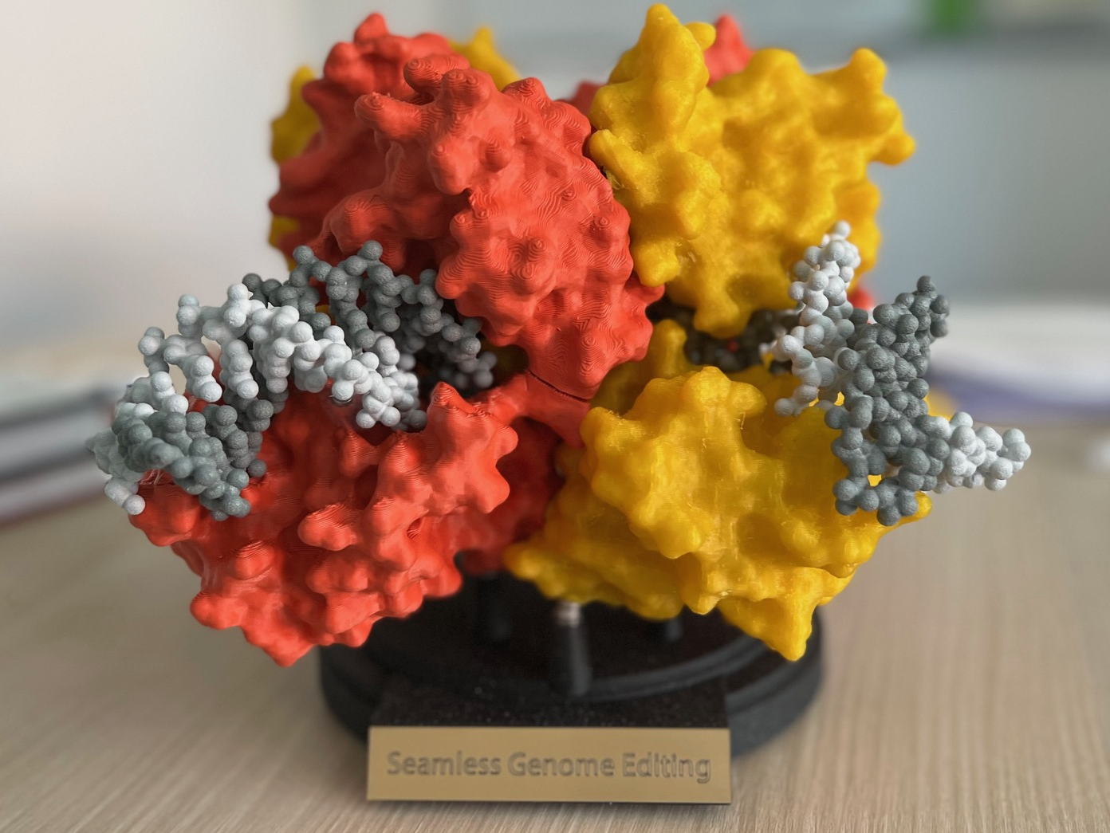








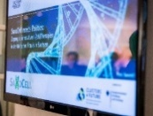
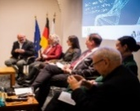
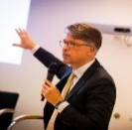
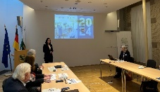
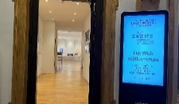
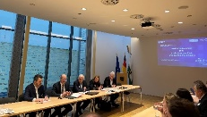

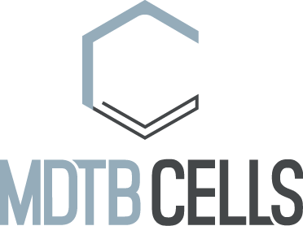



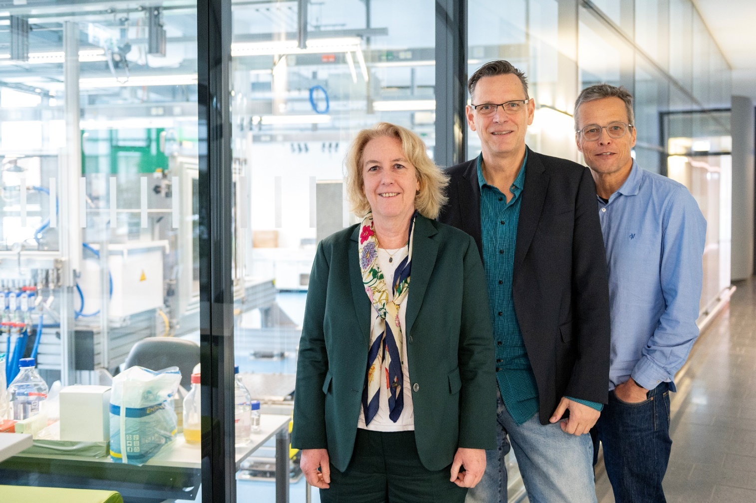
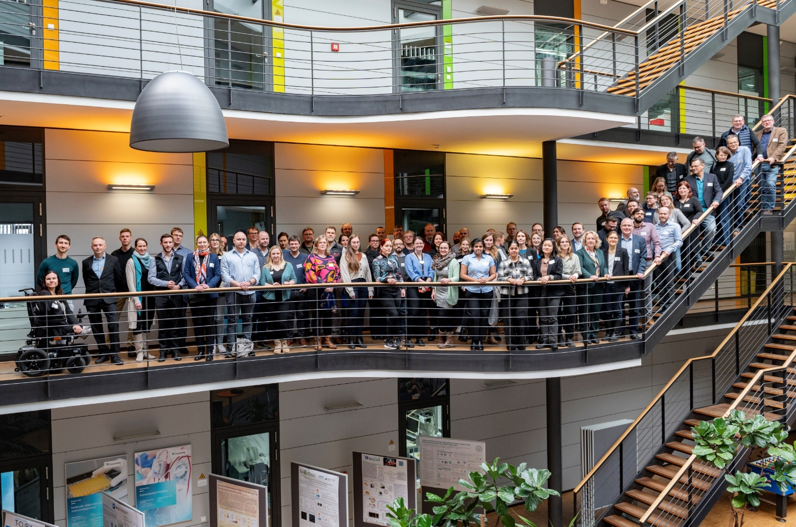







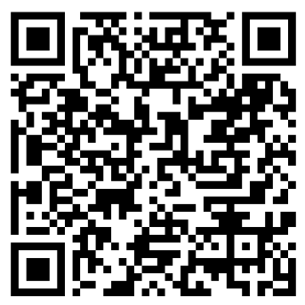
The Future of Cancer Treatment: Cell and Gene Therapies
For decades, chemotherapy has been the standard treatment for cancer—using chemical substances (cytostatics) to slow down tumor growth. However, chemotherapy is not tailored to individual patients, often causing severe side effects by harming healthy cells alongside cancer cells. The 2010s marked a turning point with the rise of personalized medicine, particularly through the approval of groundbreaking cell and gene therapies like CAR-T cell therapy. These innovative treatments harness the body's own immune system to fight cancer in a more precise and effective way.
What Are Cell and Gene Therapies?
Cell and gene therapies represent a new era in medicine, offering hope for conditions that were once considered untreatable. Unlike conventional treatments that mainly manage symptoms, these advanced therapies have the potential to provide long-term cures—particularly for genetic disorders and aggressive cancers.
The foundation of these therapies lies in harnessing the power of immune cells (such as T cells, NK cells, and macrophages) or stem cells, combined with cutting-edge gene-editing technologies. By modifying or reprogramming these cells at a molecular level, scientists can correct genetic defects, enhance immune responses, or replace damaged tissues—offering highly personalized and effective treatment options.
One-fits-all solution
Chemotherapy
Living Drugs
Tailored treatment
for specific person & diagnosis
Cell and Gene Therapies
Why Cell & Gene Therapies Are a Game Changer
✅ Targeted action – Designed to attack cancer cells specifically (e.g., CAR-T cells that recognize unique cancer markers)
✅ Long-lasting effect – Immune cells can "remember" cancer cells and help prevent relapses
✅ Fewer side effects – Less damage to healthy cells compared to chemotherapy or radiation
✅ Personalized approach – Treatments can be adapted to the unique genetic profile of the tumor
While these tailored therapies are still expensive and not yet available for all cancer types, they represent a major step toward a future where cancer treatment is more effective, individualized, and with fewer side effects. The revolution in cancer therapy has only just begun!
The aim of SaxoCell is to develop and optimize safe, effective and cost-effective cell and gene therapeutics in Saxony, the so-called living drugs. We work in a strong network of local partners from academia, healthcare and industry to make Saxony a hotspot for gene and cell therapy.
SaxoCell: Living drugs made in Saxony
Funding
SaxoCell is one of 7 winners of the BMBF's Clusters4Future initiative and prevailed nationally against 137 competitors. The first funding period started in 2021 for 3 years and a funding volume of 15 million euros. A second funding phase was secured in 2024, which followed on seamlessly from the first and is characterized by a strong increase in industrial share. We are planning a third and final funding period from 2027, but are already starting the process of cluster sustainability through the SaxoCell e.V.
Core parters of the cluster
2 Universities (TU Dresden, Leipzig University)
1 Research institute (Fraunhofer IZI)
3 Hospitals (Chemnitz Hospital, University Hospitals Dresden & Leipzig)
23 Industrial partners (regional, national & international)
2021-2024
€15mio
20% Industry share
2024-2027
€15mio
35% Industry share
2027-2030
€15mio
50% Industry share
SaxoCell e.V.
Achieving more together: The SaxoCell R&D Projects
The current SaxoCell successes
UniK-T - Developing universal, off-the-shelf CAR-T cell therapies for cancer, inflammatory, and autoimmune diseases. Using AI and adapter molecules to improve treatment precision, effectiveness, and safety.
SyafeTy - Making CAR-T and stem cell therapies safer by preventing severe immune reactions (GvHD and CRS) through innovative biotechnological approaches, including new treatment strategies like extracorporeal immunomodulation.
SB-TRACT - Automating the production of Sleeping Beauty transposon-modified T cells for treating solid tumors, making T-cell therapies more efficient and accessible.
Scientific Breakthroughs
First successful antibody production at Fraunhofer IZI (S1 GMP facility) in 2024
Further development of the Designer recombinase technology
T
Cells
Clinical Studies
ROR2 CAR-T - Fh IZI & UK Würzburg
Clinical study with ROR2-specific CAR-T cells in patients with ROR2+ tumors
NK
Cells
NK-Alliance - Advancing natural killer (NK) cell therapies for cancer and autoimmune diseases by improving genetic modifications, production processes, and clinical translation.
UC-CISSII – TU Dresden & Canadian centers
MSCs from the umbilical cord as cellular immunotherapy for septic shock
Patents
AlloMac - Developing an affordable, off-the-shelf macrophage therapy for solid tumors, using genetically modified immune cells to destroy cancer cells effectively.
Edit-Save - Creating safe, virus-free genome editing techniques to treat blood, autoimmune, and cancer diseases, using advanced gene-editing tools like recombinase and transposon systems.
MSC-READY - Scaling up the production of MSC-based cell therapies (e.g., Desacell®) for serious diseases, ensuring cost-efficient manufacturing and global clinical application.
10 new patent applications
6x macrophages, 5x genome editing, 2x NK cells, 1x T cells, 3 others
Stem
Cell
Derived
Additional Funding
xMac / AlloMac – 1mio€
UltraCART / SB-TRACT – 9mio€
SaxoCell Forums
Networking of politics & healthcare
Support for R&D projects in management and tech transfer. Sharpening the cluster strategy and strengthening Saxony as a biotech hub by expanding research-industry collaborations, funding opportunities, education programs, and investor engagement.
meets Politics
Presentation of Saxon business ideas to investors
Spin-offs & Settlements
Investors Club
SaxoCell Speakers & Consortium
3 Spin-offs
THERAPEUTICS
THERAPEUTICS
2 Settlements
Werk Sachsen
Contact & Info
Sprecher
E-Mail: info@saxocell.de
Website
Industry Flyer
Public Flyer coming soon

